Slide 1
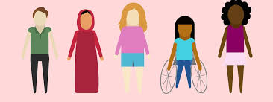
Peer to Peer Abuse
Accreditation Pathway
Contextual Safeguarding Training

Slide 2
As children grow up and experience the world around them, they may be exposed to the odd incident where another child might say something hurtful towards them, might talk about them behind their backs, make them feel uncomfortable in a social situation or physical hurt them, for example, hit them.
While these behaviours are not acceptable, hopefully they are rare in occurrence and are quickly resolved with the help of adults around them.
Younger children are better at asking adults for help but the older children are, the less likely they are to seek help. Indeed, they may not realise they are in potentially abusive situations.
Peer to peer abuse

Slide 3
What is peer to peer abuse?
Peer on peer abuse is any form of physical, emotional, sexual, financial abuse and coercive control exercised between children and within children’s relationships (both intimate and non-intimate), friendships and wider peer associations.
Peer-on-peer abuse can take various forms, including (but not limited to):
serious bullying (including cyberbullying), relationship abuse, domestic violence and abuse, child sexual exploitation, youth and serious youth violence, harmful sexual behaviour and/or
prejudice-based violence including, but not limited to, gender-based violence.
Online peer-on-peer abuse is any form of peer-on-peer abuse with a digital element,
for example, sexting, online abuse, coercion and exploitation, peer-on-peer grooming, threatening language delivered via online means, the distribution of youth involved sexualised content, and harassment.
Notes:
It is important to recognise that abuse isn’t always perpetrated by adults; children can also abuse other children and it can happen both inside and outside educationa setting. Luckily, lots of the above you will not have to worry about with your primary school aged children.
Hopefully, for those of you that have older children, we hope this information will be useful.

Slide 4
What is peer to peer abuse?
There are four key definitions:
Domestic abuse – young people who experience physical, emotional, sexual and/or financial abuse, and coercive control, in their intimate relationships, or a family relationships.
Child sexual exploitation – those under the age of 18 who are sexually abused in the context of exploitative relationships, contexts and situations, by a person of any age, including another young person.
Serious youth violence – any offence of most serious violence or weapon-enabled crime, where the victim is aged 19 or younger, e.g. wounding with intent, rape, murder and grievous bodily harm.
Harmful sexual behaviour – young people displaying sexual behaviours that are outside of developmentally ‘normative’ parameters.
Notes:
What is an abuse? It is an action taken by another person that causes harm or distress. This can be physical or mental.
Domestic abuse is also called domestic violence and it can be defined as a pattern of behaviour in any relationship that is used to gain control or power over others.
Child sexual exploitation- It is also called child molestation, and is a form of abuse in which an adult or older adolescent use a child for sexual stimulation. How is child exploitation defined?
In all cases, those exploiting the child/young person have power over them by virtue of their age, gender, intellect, physical strength and/or economic or other resources.
Violence, coercion and intimidation are common, involvement in exploitative relationships being characterised in the main by the child or young person’s limited availability of choice resulting from their social/economic and/or emotional vulnerability.
Child exploitation can happen between peers, it is not just adults that can exploit children. Indeed, it often starts with the child’s peer group, introducing them to situations that, once in, the child will find it difficult, if not impossible, to walk away from without serious repercussions.
Youth violence is a traumatic experience that can have a lifelong health and social consequences. It is often connected to the other forms of violence, iinlcuding child abuse and neglect, sexual violence, self-harm and suicide.
Harmful sexual behaviour is developmentally inapppriate sexual behaviour which is displayed by children and oung people and which maybe harmful; or abusive.
For the purpose of this guidance, the term ‘child’ refers to any young person under 18 years old.

Slide 5
49% of boys and 33% of girls aged 13 – 14 years old thought that hitting a partner would be ok in at least one of the twelve scenarios that were presented to them.
95% of all young people experiencing Domestic Abuse were female
Young People are twice as likely to self harm following abuse than older victims
52% of young LGBTQ+ people reported having experienced some form of domestic abuse, but only 37% of these young people recognised it as domestic abuse before reporting it.

Slide 6

When we talk about peer on peer abuse in young people we are thinking about three different categories:
Teenage peer relationship abuse
Dating abuse
Intimate partner abuse

Slide 7
Following data collected during work for White Ribbon Day in November with young people aged 13 -17:
•25% of girls and almost 20% of boys reported some form of
physical violence
•nearly 75% of girls and 50% of boys reported some form of
emotional violence
33% of girls and 16% of boys reported some form of intimate partner violence
•girls experienced more repeated abuse, at the same level of
severity or worse
Girls are 4 to 6 times more likely to get pregnant within abusive relationships. Risk is higher once they are pregnant.
Same sex couples are less likely to report abuse for fear they will not be believed.

Slide 8
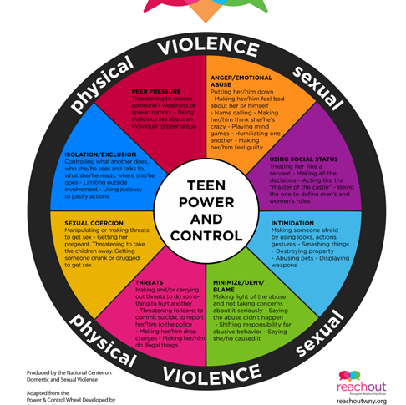
When we think about teen peer abuse, we need to first think about all of the relationships that are happening and developing within a teenager's life. This work links closely to the training last week on CPVA and the power and control wheel used for that. The same wheel can be applied to peer relationship abuse.
Notes:
. Abusive relationships involve threats and intimidation. Abusive teens may try to use social status, peer pressure or popularity to manipulate their peer into doing things, going places or supporting them to do things. They may control access to social events and friends. Threats may involve how they will portray the person or things they will share on social media. Social media can be used to monitor the person’s whereabouts or actions. It is common to try to isolate the peer from other friends and family to make sure that they have no one else to talk to, and can be jealous if they spend time with other people. Emotional abuse often occurs within peer relationship and can take many forms. Jealousy and anger are red flags to watch out for.
All of these dynamics are designed to keep the abusive partner in control and the other partner dependent on their partner and the friendship or relationship.

Slide 9
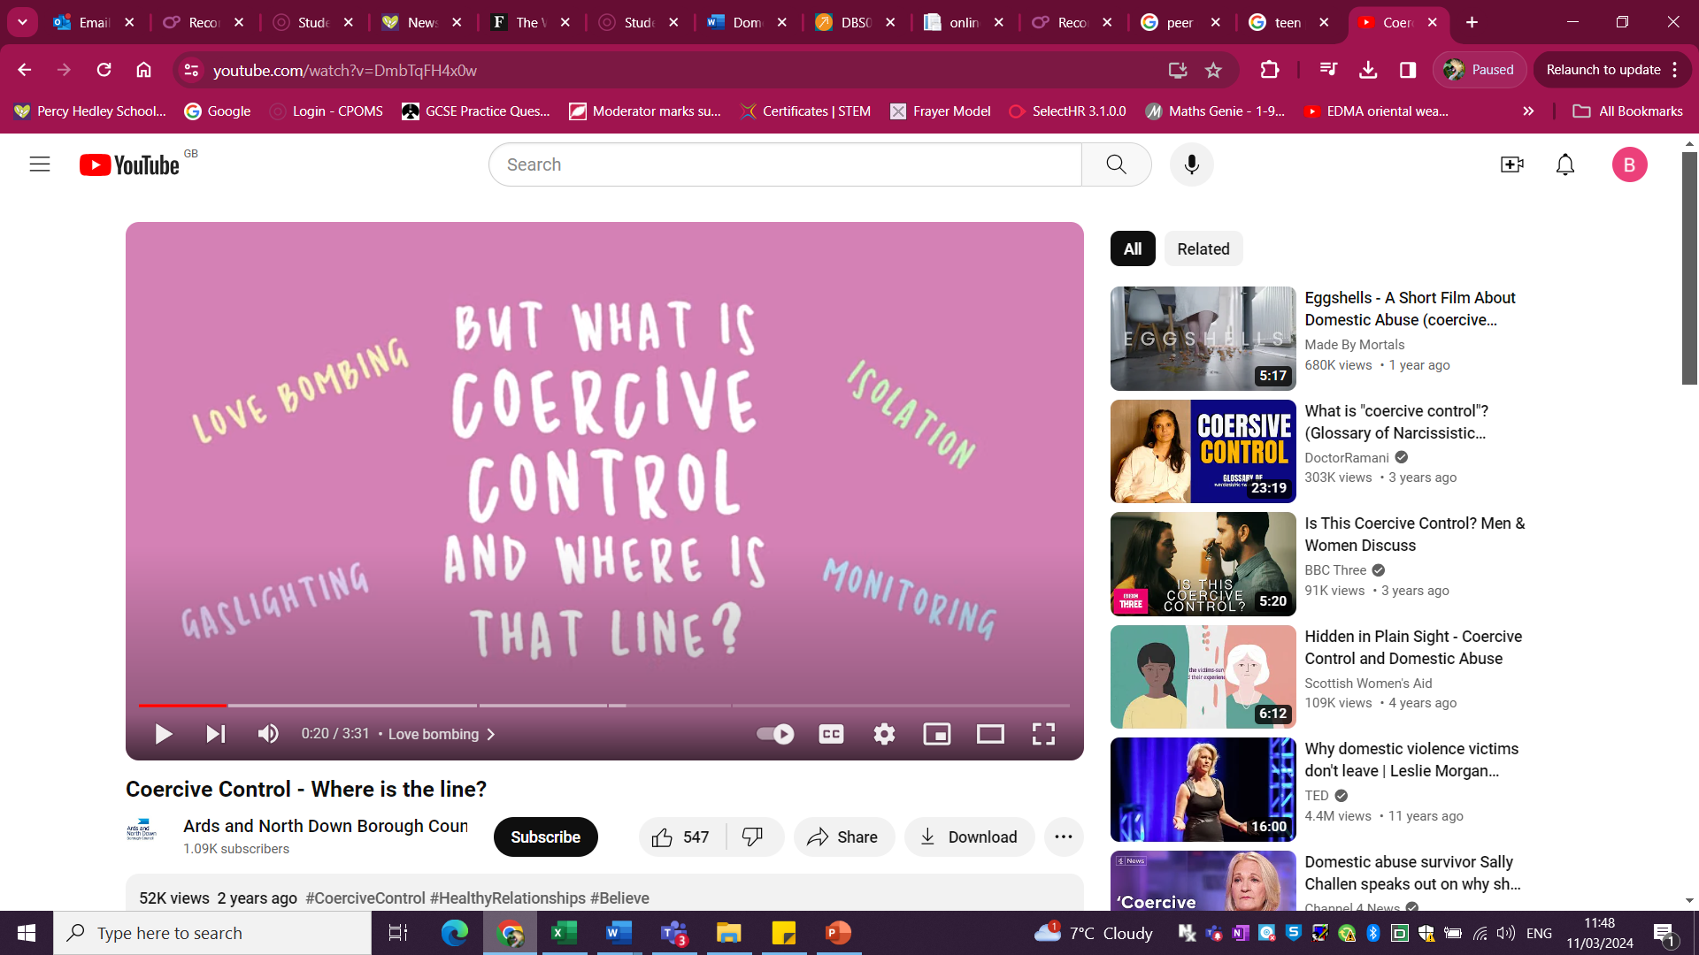
Coercive control and young people
https://www.youtube.com/watch?v=DmbTqFH4x0w

Slide 10

Use of mobile phones and social media
Since the development of social media and the use of mobile phones within young people has become prolific, this has had an impact upon statistics for peer on peer abuse:
Always contactable at all times of the day
Much harder to spot abuse, its much easier to hide.
Control around use of phones: passwords, tracking, social media
Blackmail around content
Worries around being outed about identity or sexuality

Slide 11
Intimate relationship abuse
Young relationships are often short lived, dramatic and intense.
Due to this issues are often not taken as seriously by adults due to their age.
This leaves young people reluctant to talk about issues.
Young relationships are often shaped by the views the young people and the traditional gender roles.
They are shaped by what they see at home.
Often influenced by how they see themselves.

Slide 12
Remember….
Don’t be dismissive, would you be dismissive if an adult told you the same thing.
Signpost young people to who can support them.
Contact the DSL team.
Remember they have come to you because they trust you.

Slide 13

Teen relationships can be affected by what they see in the media….
Often teen relationships are influenced by what they see and hear on TV, online, on social media and in films.
An influencing factor in peer sexual violence is porn, and the misunderstandings about what they are seeing and what they should expect from a sexual partner.
Teen pornography addiction figures are on the rise and involve children as young as 11.
Movements such as the Incel movement have affected how our young people see themselves and others. What they think is acceptable and who they blame for different things in their lives.

Slide 14
Exploitation: Children who are abused are susceptible to exploitation.
This is more likely to happen outside of the home or school where adult supervision is absent, or online.
Think about the places young people go to socialise. The local park, café, playground, shopping centre, social networking and gaming sites. All normal places that children and young people frequent and go to with their peers. But who are those peers and what are their influences.
The older children get, the less likely we are to know who they are ‘’hanging out’’ with or interacting with, the less control parents have as to who their child is mixing with.
Online exploitation is a growing concern. The highest rate of Prevent cases in the Northeast come from online exploitation of young people.

Slide 15
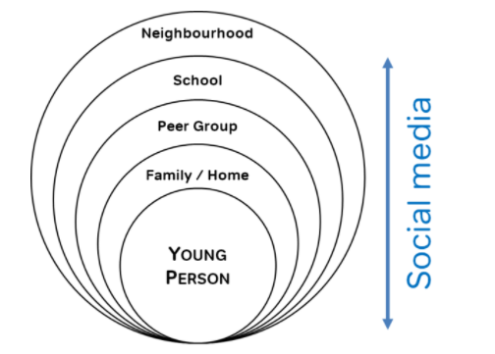

Slide 16
Vulnerability increases susceptibility for exploitation
Unsure of their sexual orientation or unable to talk to their family about it
Struggling with gender
Associating with young people who are being sexually exploited
Homelessness
Living in residential care or are a Young Carer themselves
Experiences of loss or death
Financial issues
Bullying
Having been abused before
Social isolation
Exclusion
These are just some of the circumstances that may leave children vulnerable to abuse or exploitation – it is not exhaustive

Slide 17
Signs and indicators…
Physical signs of injury
Changes in mood and personality
Isolations from family or friendship groups
Frequent texts, calls, social media usage.
Inappropriate sexual language, behaviours or attitudes
Pregnancy
New use of drugs or alcohol
Mental health issues
Self-harm
Eating disorders
Problems sleeping
Bullying behaviours
Changes in how they spend their time

Slide 18
Signs and indicators…
Changes to how they dress
Absence or continued lateness for school
Not wanting to leave school
Changes in attitudes or commitment
Gendered comments or expectations
Misogynistic or sexist comments
Toxic Masculinity
Talk of being afraid or unsafe
Talk of gangs or criminal behaviours
Appearing removed
Social Isolation

Slide 19

What can we do…
Ensure that we have services designed for children to access them, and can signpost to who or where they can get support from.
Think about how the child would like to communicate what is happening to them – length of appointments, time of appointments, flexibility, messages, emails….
Is this a child protection issues? DSL team
Listen, take them seriously, don’t promise to keep secrets
Make sure they know who they can talk to and how we can keep them safe.

