Slide 1

Positive Relationships
Advice for Young People:

Slide 2

October is Domestic Violence Awareness Month
Domestic Violence Awareness Month is designed to unite women and men all across the world who have been victims of domestic violence. It is important to recognise that domestic violence impacts millions of people, and it’s not only women who are victims; many men suffer domestic violence as well.
It is a problem across every status, culture, religion, and race. There are many different forms of domestic violence as well, which is why raising awareness is so critical.

Slide 3
Positive Relationships
Everyone deserves to have a positive relationship with the people around us. This includes friends, teachers, parents and partners.
However, sometimes there will be people in your life who seem to be there to support you, but actually their support is negative and not a positive effective on your life. It is important to recognise these people as soon as possible. You may also see or hear things , involving other people in your life, that does not have a positive effect on your life. Its important to recognise these as well.
Notes:
Discuss the image – the difference between a positive and negative relationships

Slide 4
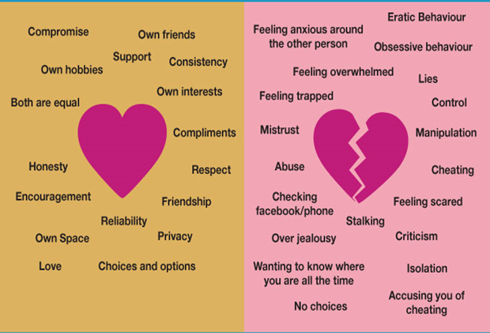
Relationships
Notes:
Discuss the image – the difference between a positive and negative relationships

Slide 5
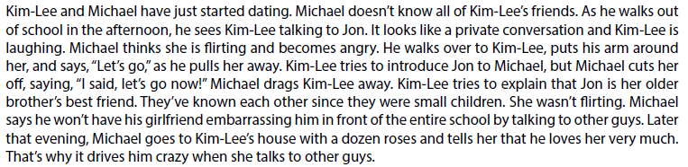

Relationships
What would you do if your were Kim-Lee?
Notes:
Discuss the image – the difference between a positive and negative relationships

Slide 6
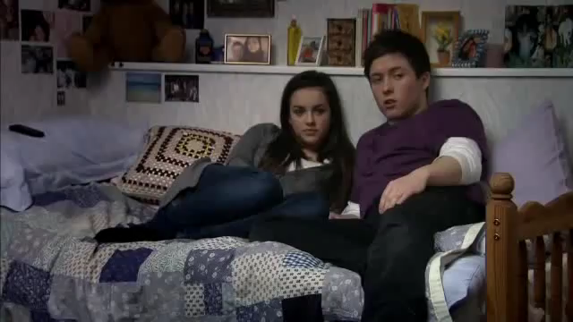
What does abuse look like?
Notes:
https://www.youtube.com/watch?v=RzDr18UYO18

Slide 7
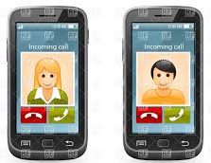
Technology
Texting
Texting too much might be a warning sign of unhealthy behaviours - it might be nice to keep in touch throughout the day, but constant contact can be a sign of controlling behaviour, especially if text messages are being used to monitor who you’re with and where you’re going. Set some healthy boundaries with your friends about texting!
Sexting
If anyone is pressuring or forcing you to send inappropriate pictures or messages, or if they are breaking your trust by threatening to share your photos, screen shots or texts, these are abusive behaviours. It’s important to note that sexting can have legal consequences - any nude photos or videos of someone younger than 18 could be considered child pornography, which is illegal to own or distribute.

Slide 8
Technology
Social Media
Staying healthy on social media is important, too! You have a right to not experience harassment or digital abuse while online or on your social networking platforms
TIPS :
• Set healthy boundaries with people around you for texting; respect your each others boundaries.
• Discuss boundaries and limits with your friends for social media - if you’re not comfortable being tagged in something, speak up.
• It’s OK to turn off your phone. It’s OK for anyone to turn off their phone.
• It’s OK to keep your passwords private. It’s OK for your friends to keep passwords private.
• Avoid responding to hostile, harassing, abusive, or inappropriate texts or messages. Tell someone.
• Only post things you want to share with the public. Think about who might see things.
• Get consent from those involved before posting anything on social media..

Slide 9
Domestic Abuse
Domestic abuse can happen anywhere, not just in the home.
It can be physical abuse, controlling behaviour or psychological abuse.
1 in 4 women and 1 in 6 men report having being affected by domestic abuse within their lives.
If you see or hear anything which makes you feel uncomfortable, scared or angry talk to someone about it – teachers, wellbeing team, LSA’s, therapists.
If you are worried for a friend, a sibling, a parent or a family member talk to someone who will be able to help you.

Slide 10
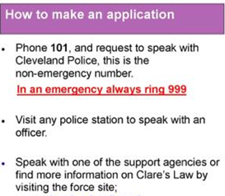
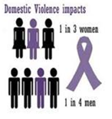
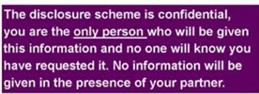
Know the Law

