Slide 1
CPVA
Child to Parent Violence and Abuse

Slide 2
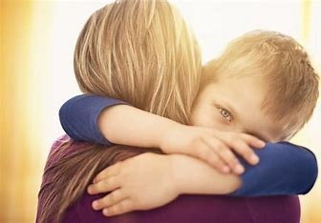
Learning objectives: - Define Child to Parent Violence and Abuse - Outline the background and context - Recognise prevalence and casual factors of CPVA - Identify behaviours which may form part of CPVA - Recognise referral routes and pathways for families

Slide 3
Case Study
- ‘Sarah’ (aged 45) was killed in November 2015, by her 16-year-old son ‘Michael’.
- Michael’s MH deteriorated in 2015 and there were numerous disclosures regarding Michael’s aggressive, threatening and violent behaviour, primarily towards Sarah and the family’s fear of Michael was directly expressed. Few of the disclosures made were actioned.
- Michael’s behavioural problems were seen as a result of his ADHD and resulted in a focus upon behaviour management.
- Michael’s age and his relationship with the primary target meant that no agency recognised the context as one of child to parent violence and abuse.
- The first large scale study of CPVA in the UK was conducted between 2010 and 2013.
- The case highlighted the need across all agencies for an increased awareness of CPVA and for multi-agency referral pathways.
Notes:
(Read screen)

Slide 4
What is CPVA?
- “Any harmful act or behaviour by a child aged 10-18yrs, whether physical, psychological, emotional or financial towards a parent/guardian or carer “ (Northumbria Police)
- A pattern of behaviour including damage to person or property, threats, stealing from the parent, humiliation or verbal abuse.
- Not just a stroppy teenager.
Notes:
- Bringing up a child is one of the most difficult responsibilities an adult can have. As children grow, they experience different stages of development which can present challenges to the adults caring for them. CPVA is (Read screen).
- Violence is not the same as anger. Anger is an emotion; violence is about power and control. Violence and abuse is any behaviour by the young person towards any family member, with the aim of controlling, domination, threatening or coercing them. (Read screen)

Slide 5
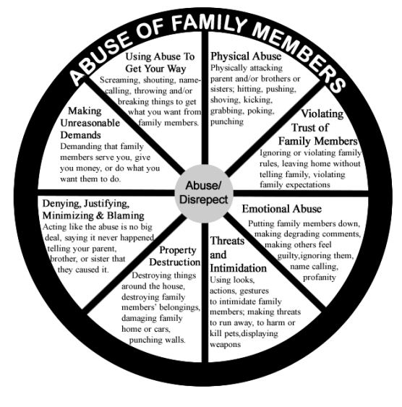
What does it look like?
Notes:
Here is what CPVA may look like

Slide 6
Why might CPVA occur in families?
Notes:
Can anyone give me some examples of why CPVA might occur in families?

Slide 7
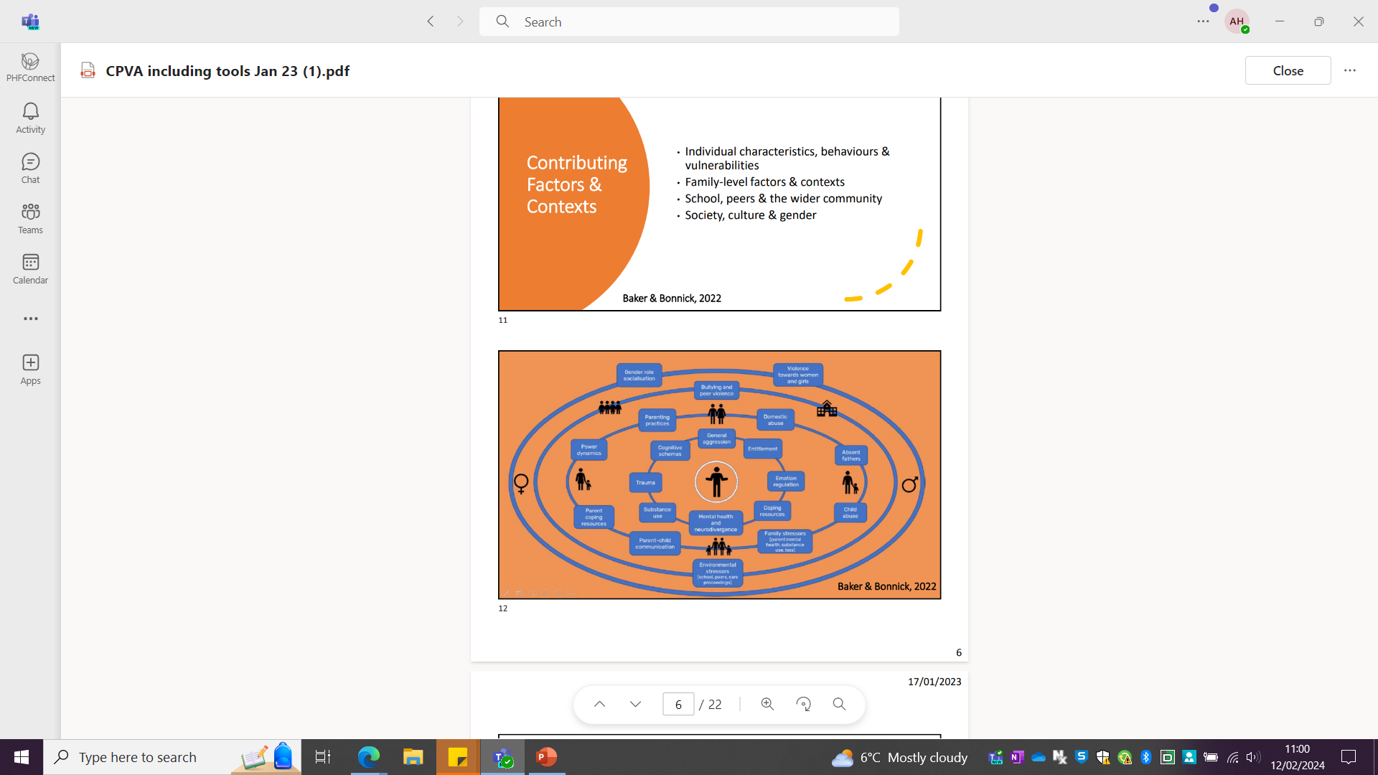
Why does CPVA happen?
Notes:
Why does it happen?
This is an ecological model of CPVA
Contributing factors and contexts can involve individual characteristics, behaviours and vulnerabilities. Family-level factors and contexts. School, peers and the wider community. Society, culture and gender.

Slide 8
Indicators and behaviours
- Physical violence (punching, spitting and kicking)
- Humiliating language and treats (name calling, shouting, swearing, belittling)
- Damage to property
- Stealing from parent/carer or running up debts
- Heightened sexualised behaviours, sexual threats, exposure to pornography
- Abusive to siblings
- Difficulties forming relationships
- Mental Health
- Self-harm or suicidal tendencies
- Disengaging from education
- Misusing substances
- Obsessive use of violent games/pornography
- Poor coping skills
- Engage in risk taking behaviours
- Threaten to use or using knives/other weapons
- Threaten to run away
- Harming or threatening to harm animals/pets
- Parent is fearful of the child

Slide 9

How to respond
- Report it to someone you trust if it is happening to you.
- If it is reported to you: Reassure, “you’ve done the right thing in telling us…… it’s not okay for your child to hit you or threaten you like this”.
- Reduce guilt, “this is not your fault”.
- Signposting to services, “we can help to find you some support”.

Slide 10
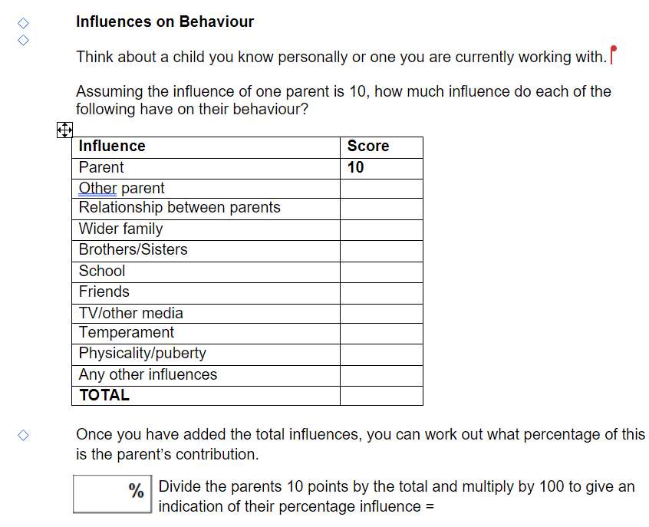
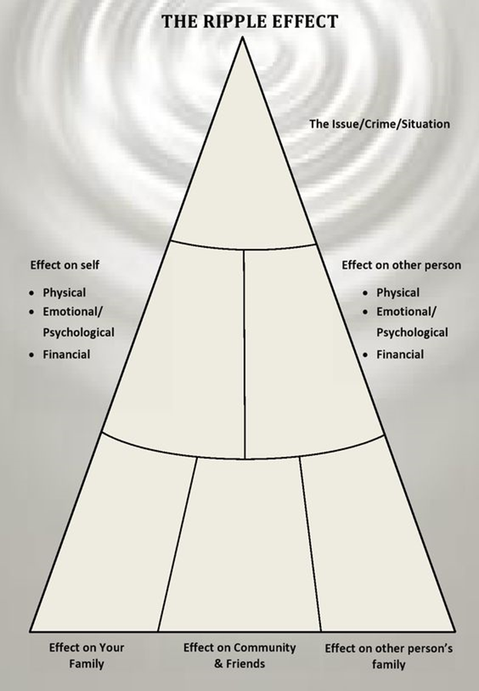
Tools to support - Identifying influences on behaviour - Signs of safety - Ripple effect
Notes:
Some of the tools used by childrens services include:
Identifying influences on behaviour, this looks at external influences such as parent, school, friends, media etc and a percentage is calculated after all the categories have been scored.
Signs of safety which is something used within North Tyneside Children's Services. Signs of Safety is about parents/carers, children and their network (the people they trust) working together so that their children can be safe and well. Rather than professionals like social workers, teachers or health visitors having all the answers or telling parents/carers what they should do, Signs of Safety helps us to recognise that families and their networks are the experts in their lives and this way of working helps us all to put children at the heart of assessments and planning.
The ripple effect is a visual that can be looked at with the young person. The crime, issue or situation is at the top of the triangle. The middle section of the triangle look at the effect on themselves and the other person (victim) (physcially, emotionally etc) and the bottom section of the triangle is about how this impacts the young persons family, friends and community and the impact this has on the other person (victim).

Slide 11
Referral route
- Contact the local authority (Children’s Services)
-Speak to the DSL at school
-If you are in danger ring the police
National support services:
- GALOP - Family Right Days
Helpline: 0800 999 5428 Advice line: 0808 801 0366
help@galop.org.uk
- Family Lives - Emergency
Helpline: 0808 800 222 Northumbria Police: 999 or 101 for non-emergency

