Slide 1
Transitions

Slide 2
Where it begins…
Moving towards adulthood is a big change for learners and their families. We aim to provide information, support and advice to enable informed decisions to be made. From Year 9 onwards transition planning will begin involving reviewing EHCP and ensuring Preparation for adulthood targets are in place.
This will be a multi-disciplinary team approach to ensure contribution and consistency across all areas including parents/carers, social care, health and education.

Slide 3
Preparation for adulthood
Independent living skills
Friends, Relationships and community
Good health and wellbeing
World of work

Slide 4
Careers
Our aim is to provide our learners with information, advice and guidance on the full range of opportunities available to them as they progress through their education and onto their next transitions and in to adulthood.
We intend to raise the aspirations of our learners and provide them with the knowledge and skills to develop their own career path.
Careers is defined as a pathway through life which is individual for each learners. This can include
Further education
Paid work
Voluntary work
Apprenticeships
Traineeships
Social care package

Slide 5
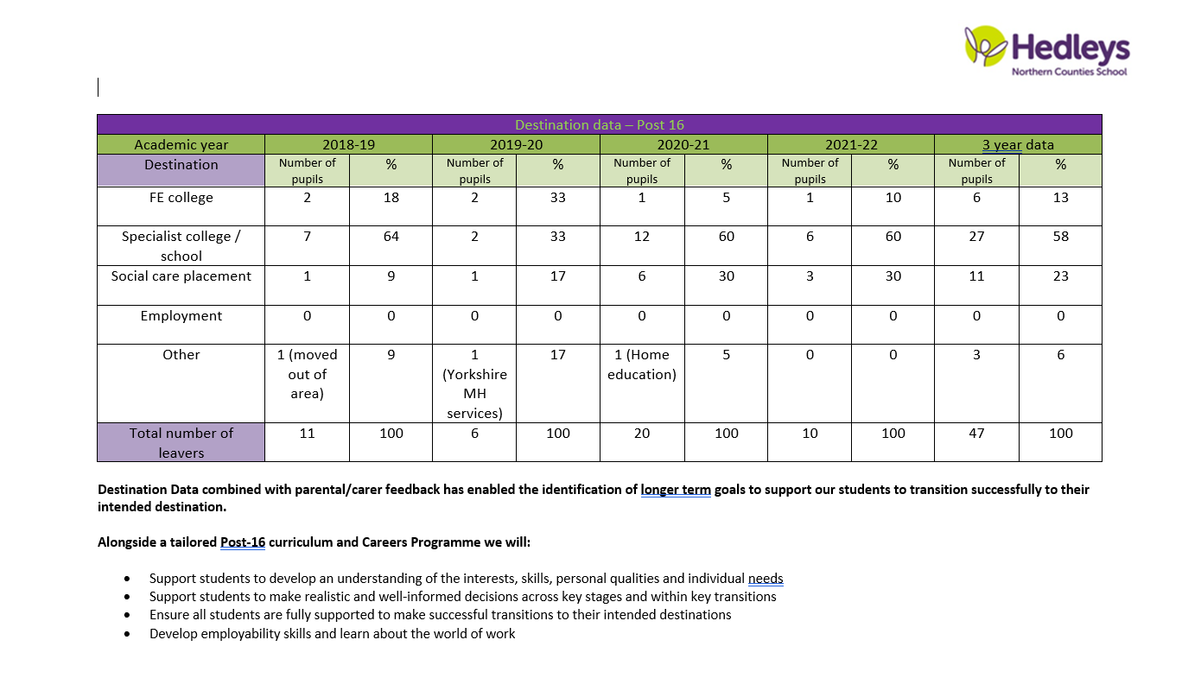
Destination data

Slide 6
Identifying an appropriate provision
Inform LEA (via social worker or case worker) of your placement preference (some LEA’s may require a parental preference form to be completed)
Discuss within multi-disciplinary team learners individual needs and potential appropriate provision.
Arrange to visit potential providers
Discussions
Visit
preference
Research
Visit
Find further information about potential providers (useful links provided at the end)
If appropriate support learners to visit potential providers

Slide 7
What next?
Application
Information sharing
Assessment
Funding
Complete application for identified provision.
Individual providers can give further advice and guidance on their process.
Providers will request information from all agencies involved with the learners to fully understand their needs.
Parents/carers opportunity to gain as much information as possible about the provision.
Providers will carry out assessments to identify if they are able to meet learners needs. (Individual providers may have varying processes)
If a provision identifies they can meet learners needs a placement would be offered. This would then go to the funding panel to agree funding. (Social worker/case manager will lead in this process)

Slide 8
TRANSITION PLAN
Following an offer of placement and confirmation of funding a transition plan would be created and implemented by an MDT.
Information sharing
Observations
Visits

Slide 9
Helpful links
Northern Counties school careers page-
https://www.percyhedley.org.uk/northern-counties-school/careers/
NATSPEC (directory of specialist further education) -
https://natspec.org.uk/colleges/
Newcastle local offer-
https://www.newcastle.gov.uk/services/schools-learning-and-childcare/special-educational-needs-andor-disabilities-send
North Tyneside local offer-
https://my.northtyneside.gov.uk/category/1243/local-offer-special-educational-needs-and-disabilities-send
South Tyneside local offer-
https://sendlocaloffer.southtyneside.gov.uk/
Northumberland local offer-
https://www.northumberland.gov.uk/Children/Northumberland-Local-Offer-SEND-0-to-25-years.aspx
Gateshead local offer-
https://gateshead-localoffer.org/information-advice-services-and-support/
Durham local offer-
http://www.countydurhamfamilies.info/kb5/durham/fsd/localoffer.page?localofferchannel=0

