Slide 1
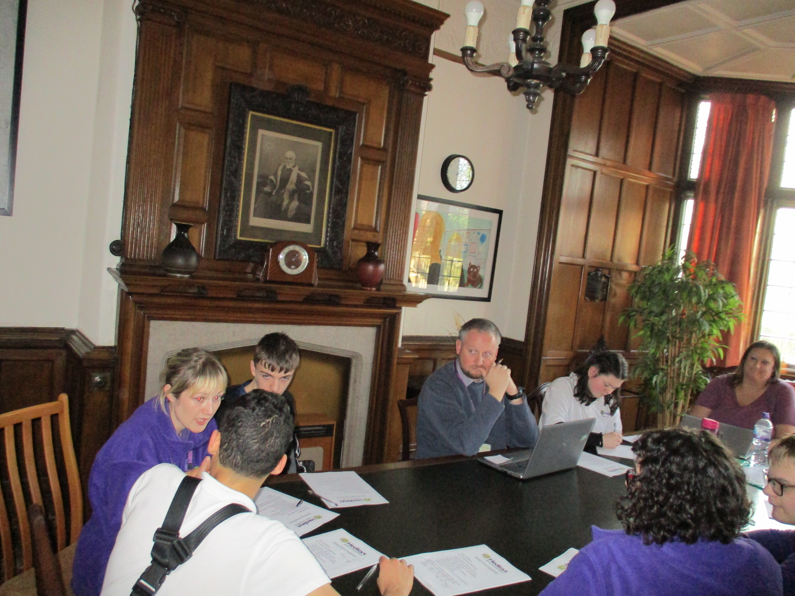
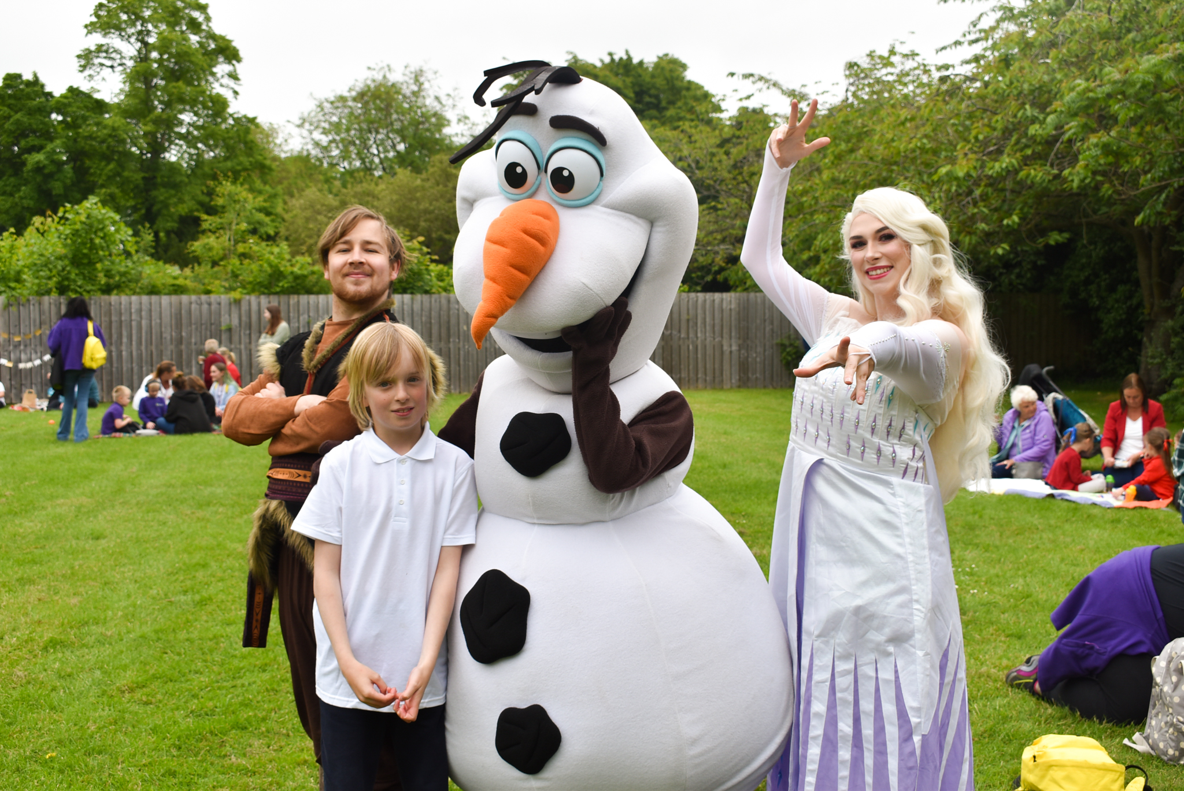
Wellbeing at NCS

Slide 2
Wellbeing at NCS
Wellbeing at NCS
Parents/Carers
Staff
Mental Health
and Wellbeing
Students
At NCS Wellbeing is a priority, working alongside and with the help of the multidisciplinary team we can maintain high standards of support and wellbeing in and around school, This creates an environment that students and staff can thrive within a positive and safe culture.
The World Health Organisation defines wellbeing and mental health as
…a state of well-being in which every individual realises his or her own potential, can cope with stresses of life, can work productively and fruitfully, and is able to contribute to his or her community.
Mental health and wellbeing is not just the absence of mental health issues, we want everyone in our school community to feel
confident
Safe to communicate feelings and emotions.
Valued and connected
This ties in with the core values of Positive Behavior Support “The overall aim of Positive Behavior Support is to improve the quality of a person’s life and that of the people around them. This includes children, young people adults as well as older people.”

Slide 3
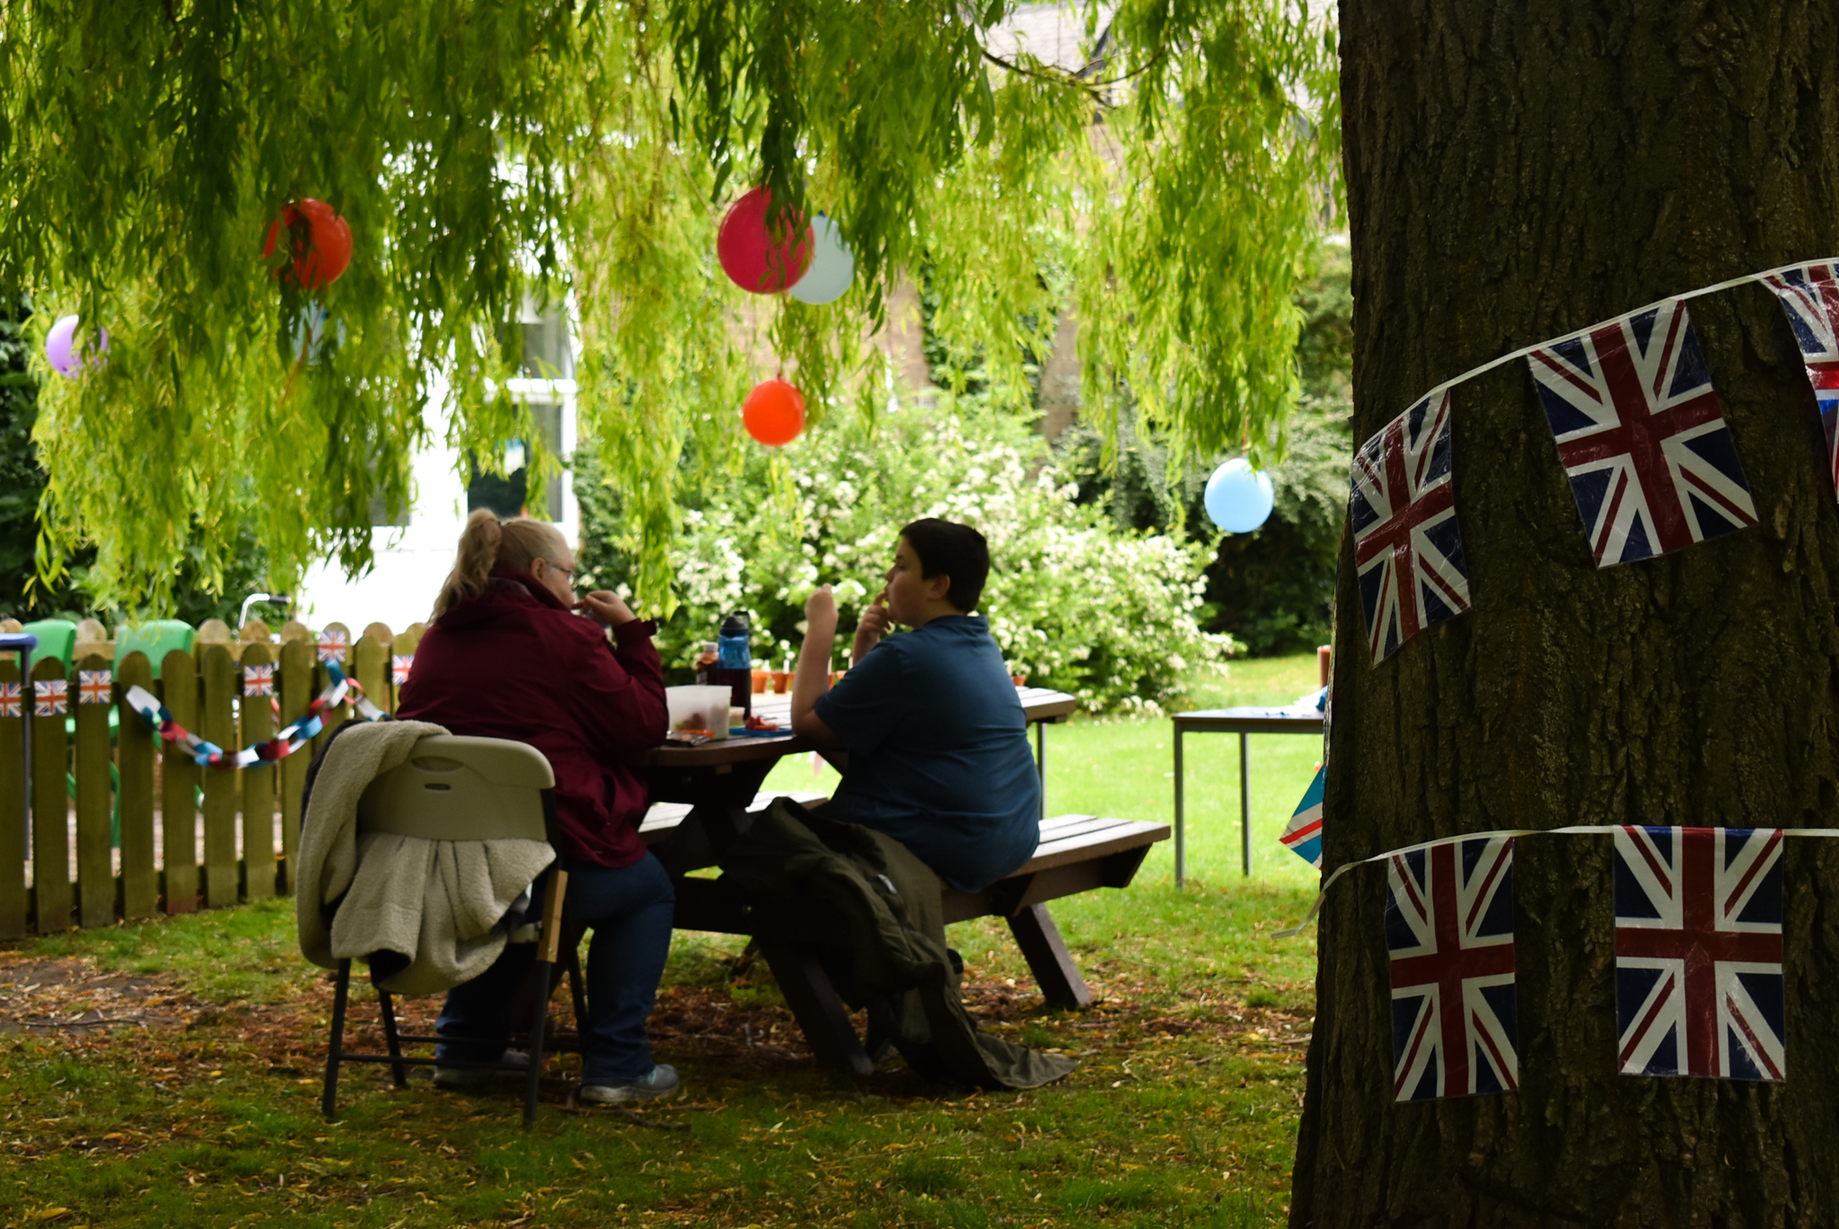
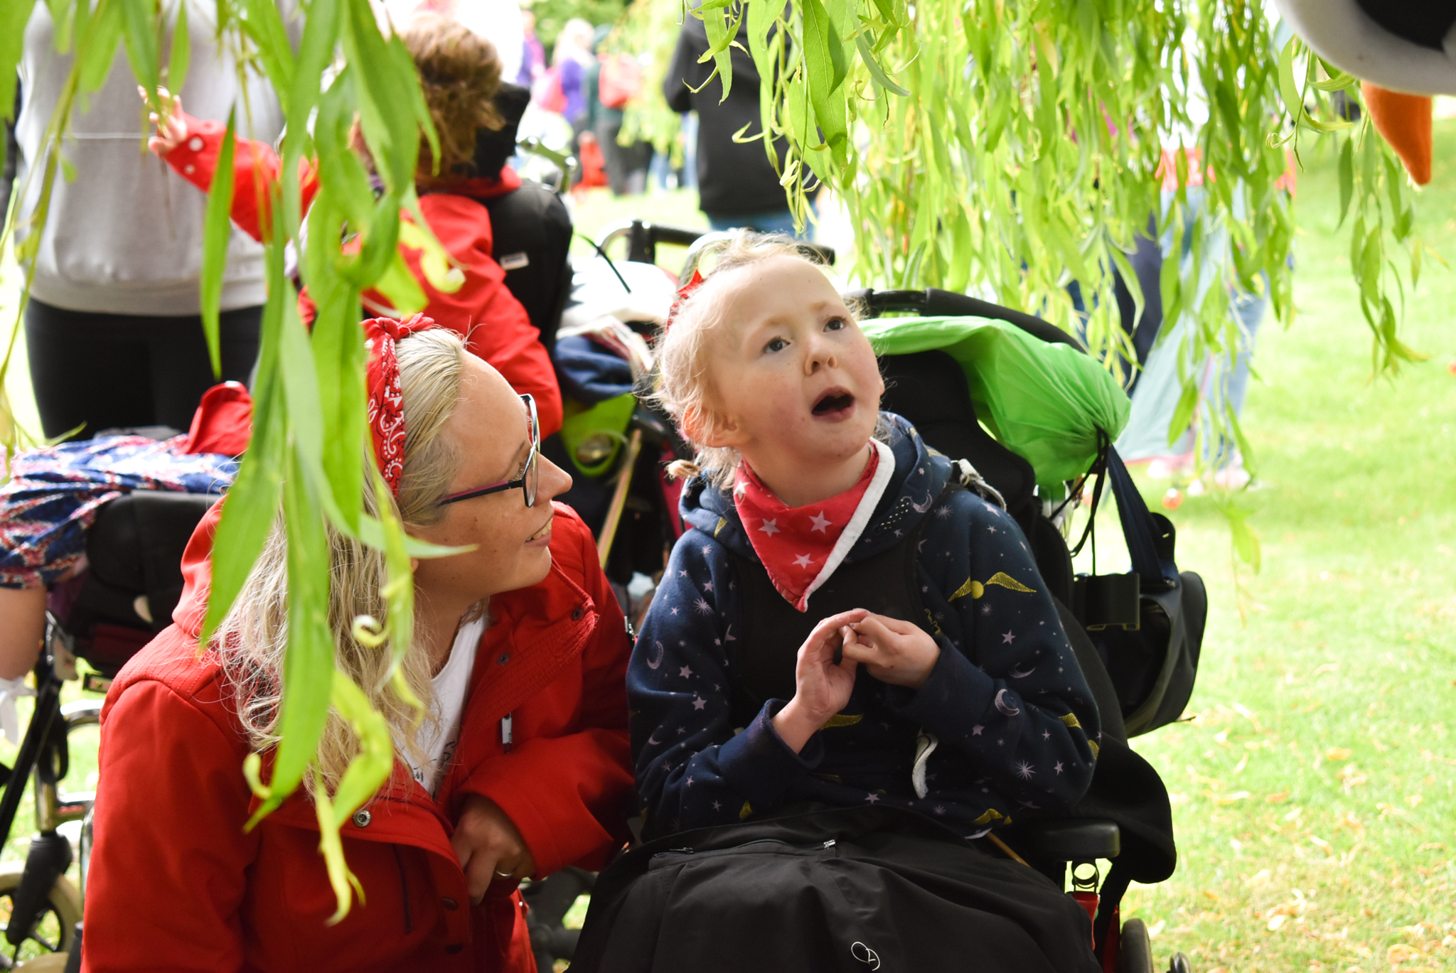
Friends of Northern Counties school/PTA- May 2023 update
Parents and carers meet on a regular basis to discuss ways in which we can improve our school and community.
We currently have Parents, Carers , Grandparents and Siblings signed up; the more the merrier.
We thought we would share a little about what we’ve achieved so far, our current aims and how your input can help make a positive change. If you have any questions or suggestions, please contact Lorna (contact details our at the bottom of the page)
We had a successful PBS(Positive behaviour support) focused Coffee morning in April run by some of the PBS team, parents and carers had the opportunity to discuss students plans and ask any question- We will keep you updated with future PBS coffee days.
Our next coffee morning is on Monday 5th June and is focused around internet safety. Our next Friends of NCS(PTS) gathering will be on Tuesday 13th June at 9.30am .
This year (since April 2022) our dedicated team of parents/carers have helped the school in many ways to implement positive changes.
Following on from our meetings, Lorna the schools wellbeing and engagement officer meets with Martin (Headteacher) and any other relevant staff to follow up suggestions, ideas and concerns. We then discuss outcomes in the next meeting.
Changes we have made so far :
Communication- Increase in communication between school and home has now improved, hopefully you will be receiving more photos and updates.
Training- The communications team is currently developing a parent page on the website to access information/training videos.
Parent/carer informal days- Regular chances to check in and attend school events such as coffee mornings increased – Yearly school calendar created with events and other important dates.
And many more things
Raised funds for wellbeing events– Raised over £50 (Not including donations of vouchers and raffle prizes and easter eggs ).
Planned events- Summer picnic for families etc
Hope to see you at one of our next upcoming evens. Thank you all for your continued support!
Notes:
Linked evidence
Attendance data
Case studies
Fixed term exclusion data
Parent views – JL annual review

